Slide 1
Week 8

Slide 2
Warm up questions!

Slide 3
From the quiz…
What is the difference between Gibbs Entropy and Boltzmann’s Entropy? When would you use either?

Slide 4
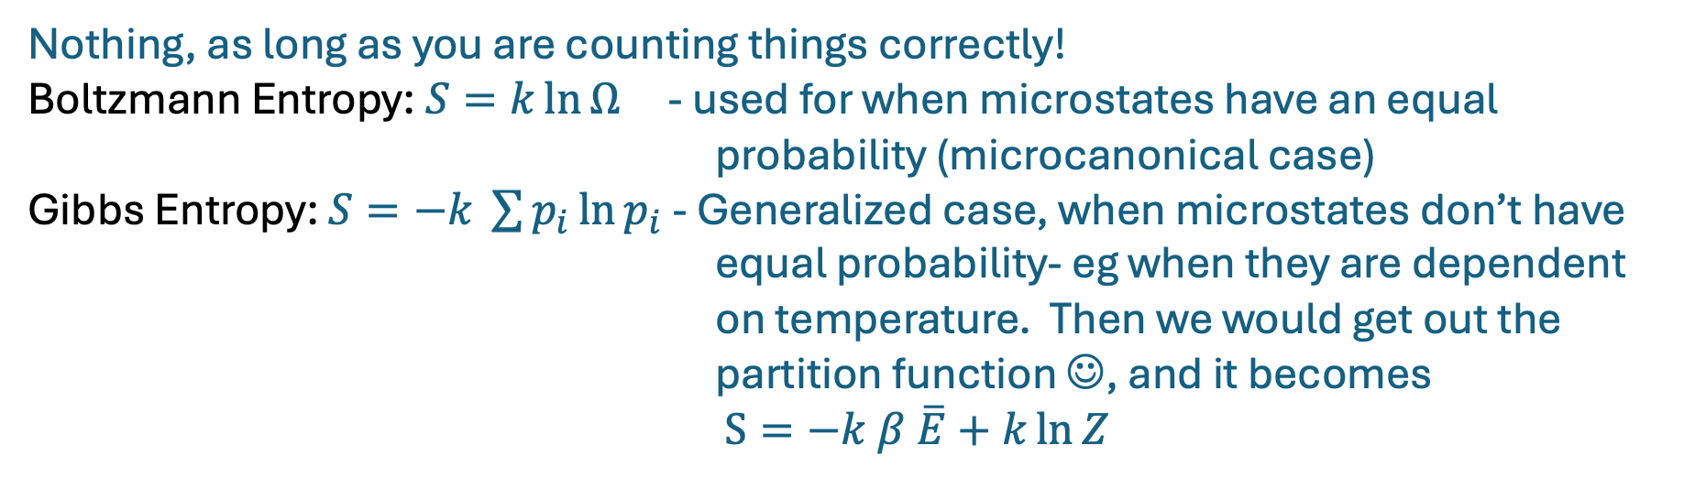
From the quiz…
What is the difference between Gibbs Entropy and Boltzmann’s Entropy? When would you use either?
Nothing, as long as you are counting things correctly!
Boltzmann Entropy: $S=k\ln{Ω}$ - used for when microstates have an equal probability (microcanonical case)
Gibbs Entropy: $S=−k \sum{p_{i}}\ln{p_{i}}$ - Generalized case, when microstates don’t have equal probability- eg when they are dependent on temperature. Then we would get out the partition function ☺, and it becomes
$S=−k β \overline{E}+k\ln{Z}$

Slide 5
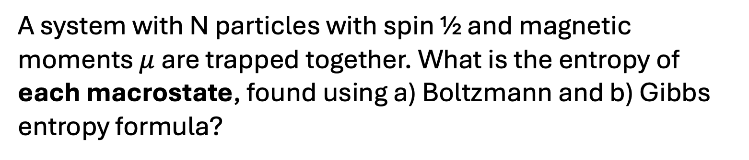

Let’s put it into practice!
A system with N particles with spin ½ and magnetic moments $μ$ are trapped together. What is the entropy of each macrostate, found using a) Boltzmann and b) Gibbs entropy formula?
Boltzmann Entropy: $S=k\ln{Ω}$
Gibbs Entropy: $S=−k \sum{p_{i}}\ln{p_{i}}$

Slide 6
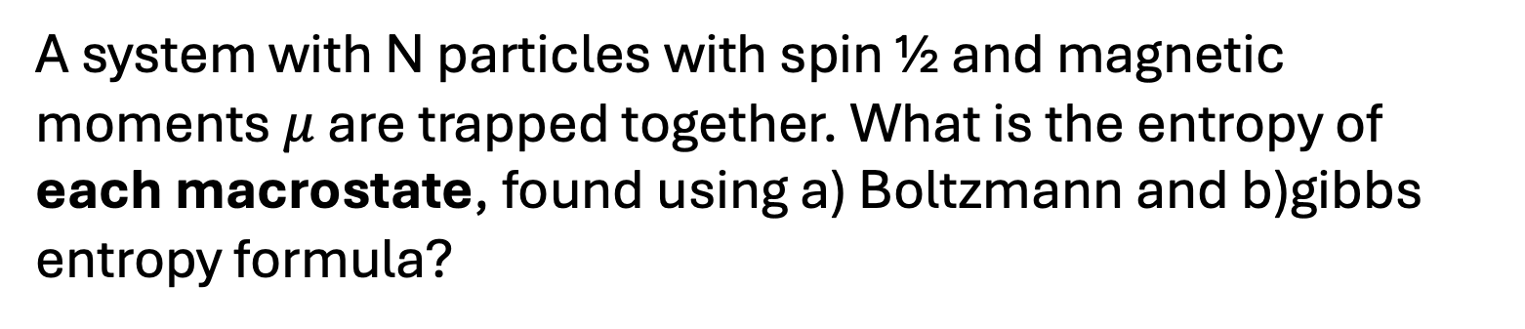
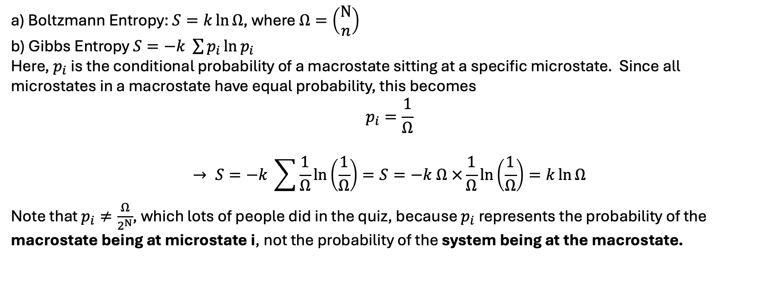
Let’s put it into practice!
A system with N particles with spin ½ and magnetic moments $μ$ are trapped together. What is the entropy of each macrostate, found using a) Boltzmann and b)gibbs entropy formula?
a) Boltzmann Entropy: $S=k\ln{Ω}$, where $Ω=\left(\begin{aligned}N \\ n\end{aligned}\right)$
b) Gibbs Entropy $S=−k \sum{p_{i}}\ln{p_{i}}$
Here, $p_{i}$is the conditional probability of a macrostate sitting at a specific microstate. Since all microstates in a macrostate have equal probability, this becomes
$$p_{i}=\frac{1}{Ω}$$
$$→ S=−k \sum{\frac{1}{Ω}}\ln\left(\frac{1}{Ω}\right)=S=−k Ω ×\frac{1}{Ω}\ln\left(\frac{1}{Ω}\right)=k\ln{Ω}$$
Note that $p_{i}≠\frac{Ω}{2^{N}}$, which lots of people did in the quiz, because $p_{i}$represents the probability of the macrostate being at microstate i, not the probability of the system being at the macrostate.

Slide 7
Now we are going to do a bunch of questions, that keep getting harder, but all follow the same method:
Figure out the number of particles and degeneracies
Find the Hamiltonian
Find the density of states

Slide 8
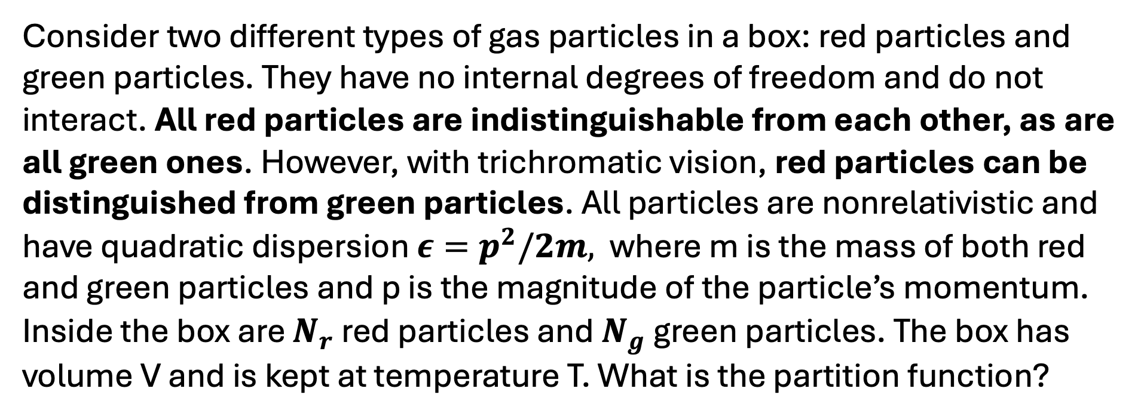
Consider two different types of gas particles in a box: red particles and green particles. They have no internal degrees of freedom and do not interact. All red particles are indistinguishable from each other, as are all green ones. However, with trichromatic vision, red particles can be distinguished from green particles. All particles are nonrelativistic and have quadratic dispersion $ε=p^{2}/2m,$ where m is the mass of both red and green particles and p is the magnitude of the particle’s momentum. Inside the box are $N_{r}$ red particles and $N_{g}$ green particles. The box has volume V and is kept at temperature T. What is the partition function?

Slide 9
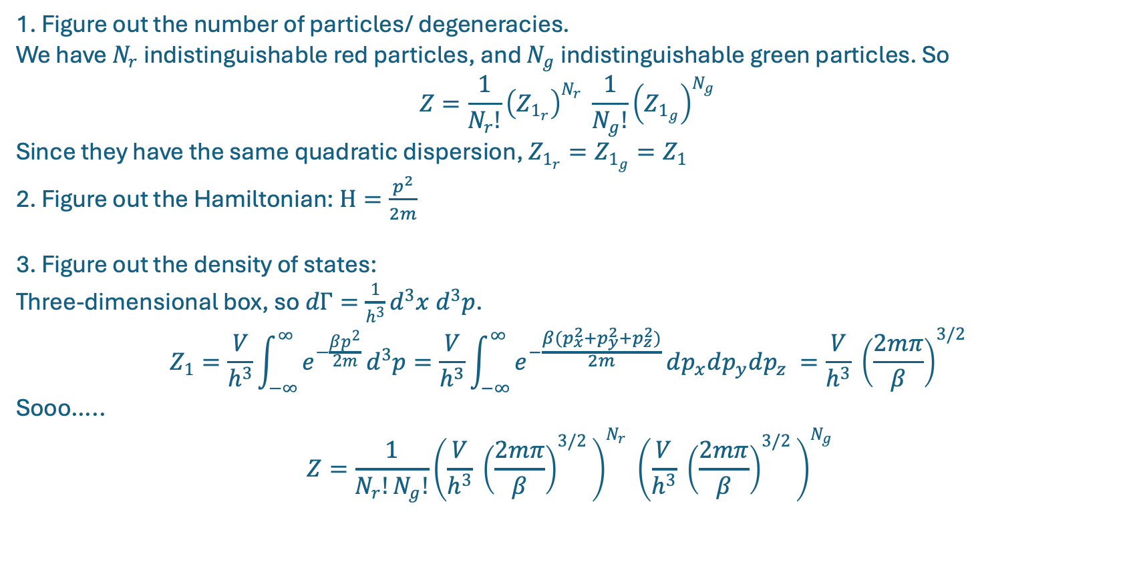
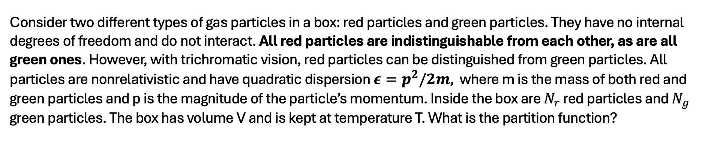
Consider two different types of gas particles in a box: red particles and green particles. They have no internal degrees of freedom and do not interact. All red particles are indistinguishable from each other, as are all green ones. However, with trichromatic vision, red particles can be distinguished from green particles. All particles are nonrelativistic and have quadratic dispersion $ε=p^{2}/2m,$ where m is the mass of both red and green particles and p is the magnitude of the particle’s momentum. Inside the box are $N_{r}$ red particles and $N_{g}$ green particles. The box has volume V and is kept at temperature T. What is the partition function?
1. Figure out the number of particles/ degeneracies.
We have $N_{r}$ indistinguishable red particles, and $N_{g}$ indistinguishable green particles. So
$$Z=\frac{1}{N_{r}!}{\left(Z_{1_{r}}\right)}^{N_{r}} \frac{1}{N_{g}!}{\left(Z_{1_{g}}\right)}^{N_{g}}$$
Since they have the same quadratic dispersion, $Z_{1_{r}}=Z_{1_{g}}=Z_{1}$
2. Figure out the Hamiltonian: $H=\frac{p^{2}}{2m}$
3. Figure out the density of states:
Three-dimensional box, so $dΓ=\frac{1}{h^{3}}d^{3}x d^{3}p$. $$Z_{1}=\frac{V}{h^{3}}\int_{−∞}^{∞}{e^{−\frac{βp^{2}}{2m}}}d^{3}p=\frac{V}{h^{3}}\int_{−∞}^{∞}{e^{−\frac{β{(p}_{x}^{2}+p_{y}^{2}+p_{z}^{2})}{2m}}}dp_{x}dp_{y}dp_{z} =\frac{V}{h^{3}} {\left(\frac{2mπ}{β}\right)}^{3/2 }$$
Sooo…..
$$Z=\frac{1}{N_{r}!N_{g}!}{\left(\frac{V}{h^{3}} {\left(\frac{2mπ}{β}\right)}^{3/2 }\right)}^{N_{r}} {\left(\frac{V}{h^{3}} {\left(\frac{2mπ}{β}\right)}^{3/2 }\right)}^{N_{g}}$$

Slide 10
Find the partition function for an isothermal ideal gas in Earth’s gravitational field. It is easiest to consider a column containing the gas, with area of A and height going from the surface of the earth to the atmosphere. You can treat the gravitational acceleration g as constant over earth’s atmosphere. Find the atmospheric pressure as a function of height above the earth’s surface.

Slide 11
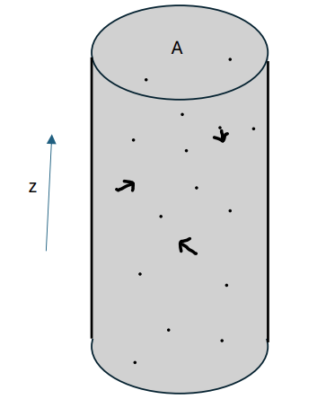
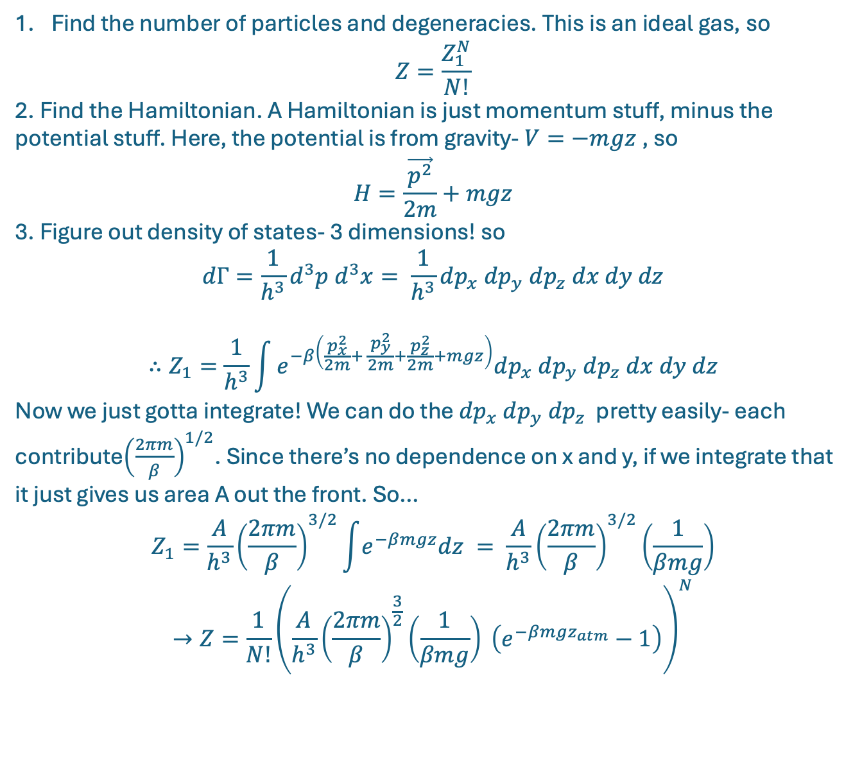
Find the number of particles and degeneracies. This is an ideal gas, so $Z=\frac{Z_{1}^{N}}{N!}$
2. Find the Hamiltonian. A Hamiltonian is just momentum stuff, minus the potential stuff. Here, the potential is from gravity- $V=−mgz$, so
$$H=\frac{\vec{p^{2}}}{2m}+mgz$$
3. Figure out density of states- 3 dimensions! so
$$dΓ=\frac{1}{h^{3}}d^{3}p d^{3}x= \frac{1}{h^{3}}dp_{x} dp_{y} dp_{z} dx dy dz$$
$$∴Z_{1}=\frac{1}{h^{3}}\int{e^{−β\left(\frac{p_{x}^{2}}{2m}+ \frac{p_{y}^{2}}{2m}+\frac{p_{z}^{2}}{2m}+mgz\right)}dp_{x} dp_{y} dp_{z} dx dy dz}$$
Now we just gotta integrate! We can do the $dp_{x} dp_{y} dp_{z}$ pretty easily- each contribute${\left(\frac{2πm}{β}\right)}^{1/2}$. Since there’s no dependence on x and y, if we integrate that it just gives us area A out the front. So…
$$Z_{1}=\frac{A}{h^{3}}{\left(\frac{2πm}{β}\right)}^{3/2}\int{e^{−βmgz}dz }= \frac{A}{h^{3}}{\left(\frac{2πm}{β}\right)}^{3/2}\left(\frac{1}{βmg}\right)$$
$$→Z=\frac{1}{N!}{\left(\frac{A}{h^{3}}{\left(\frac{2πm}{β}\right)}^{\frac{3}{2}}\left(\frac{1}{βmg}\right) \left(e^{−βmgz_{atm}}−1\right)\right)}^{N}$$

Slide 12
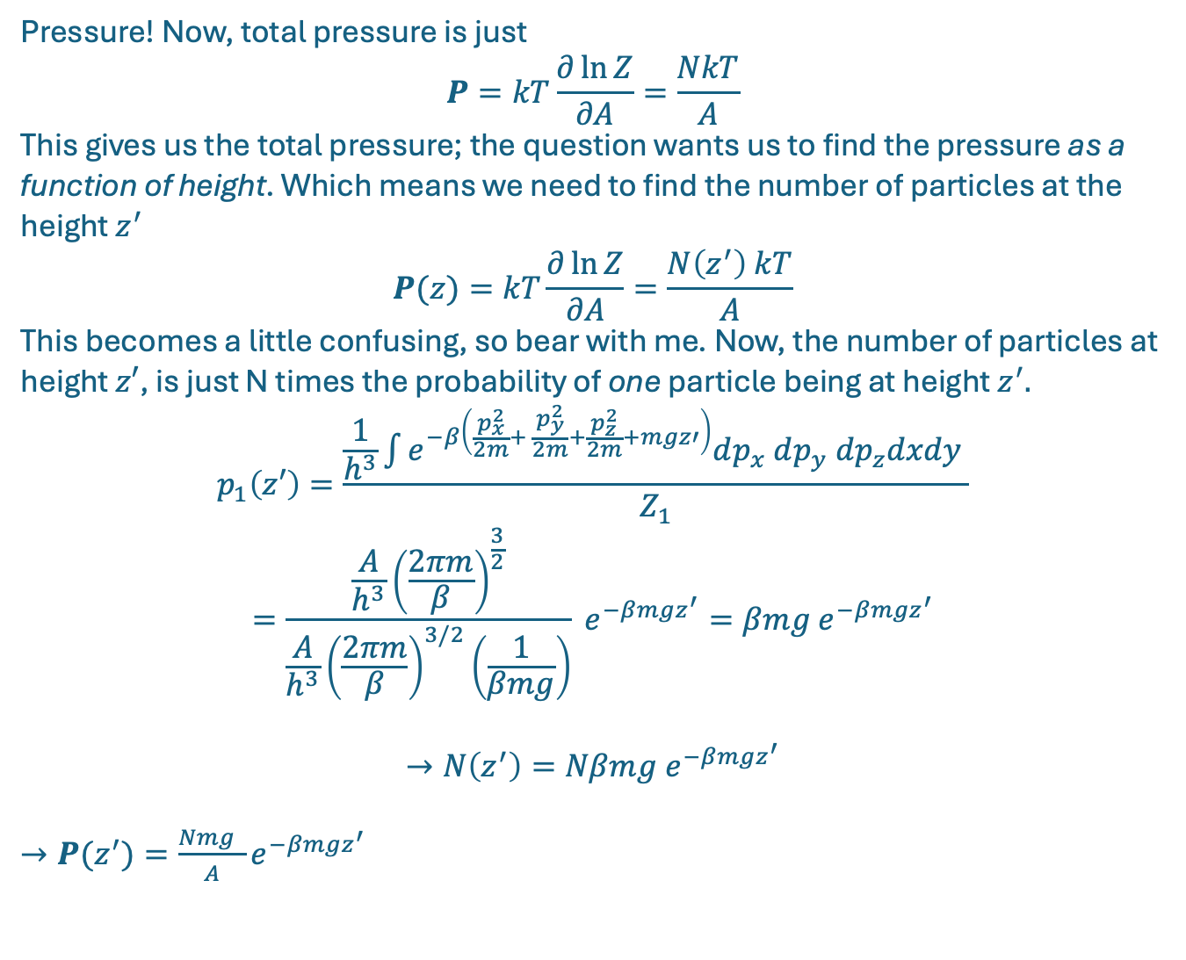
Pressure! Now, total pressure is just
$$P=kT\frac{∂\ln{Z}}{∂A}=\frac{NkT}{A}$$
This gives us the total pressure; the question wants us to find the pressure as a function of height. Which means we need to find the number of particles at the height $z^{′}$ $$P(z)=kT\frac{∂\ln{Z}}{∂A}=\frac{N\left(z^{′}\right) kT}{A}$$
This becomes a little confusing, so bear with me. Now, the number of particles at height $z′$, is just N times the probability of one particle being at height $z^{′}.$
$$p_{1}\left(z′\right)=\frac{\frac{1}{h^{3}}\int{e^{−β\left(\frac{p_{x}^{2}}{2m}+ \frac{p_{y}^{2}}{2m}+\frac{p_{z}^{2}}{2m}+mgz′\right)}dp_{x} dp_{y} dp_{z}dxdy} }{Z_{1}}$$
$$=\frac{\frac{A}{h^{3}}{\left(\frac{2πm}{β}\right)}^{\frac{3}{2}}}{\frac{A}{h^{3}}{\left(\frac{2πm}{β}\right)}^{3/2}\left(\frac{1}{βmg}\right)} e^{−βmgz^{′}}=βmg e^{−βmgz^{′}}$$
$$→N\left(z^{′}\right)=Nβmg e^{−βmgz^{′}}$$
$→P(z^{′})=\frac{Nmg }{A}e^{−βmgz^{′}}$

Slide 13
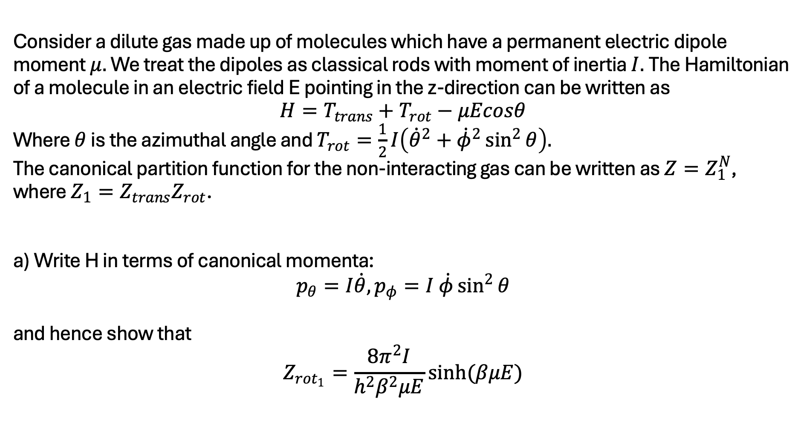
Consider a dilute gas made up of molecules which have a permanent electric dipole moment $μ.$ We treat the dipoles as classical rods with moment of inertia $I.$The Hamiltonian of a molecule in an electric field E pointing in the z-direction can be written as $$H=T_{trans}+T_{rot}−μEcosθ$$ Where $θ$ is the azimuthal angle and $T_{rot}=\frac{1}{2}I\left({\dot{θ}}^{2}+{\dot{φ}}^{2}\sin^{2}{θ}\right).$ The canonical partition function for the non-interacting gas can be written as $Z=Z_{1}^{N}$, where $Z_{1}=Z_{trans}Z_{rot}$. a) Write H in terms of canonical momenta: $$p_{θ}=I\dot{θ}, p_{φ}=I \dot{φ}\sin^{2}{θ}$$ and hence show that $$Z_{rot_{1}}=\frac{8π^{2}I}{h^{2}β^{2}μE}sinh(βμE)$$

Slide 14
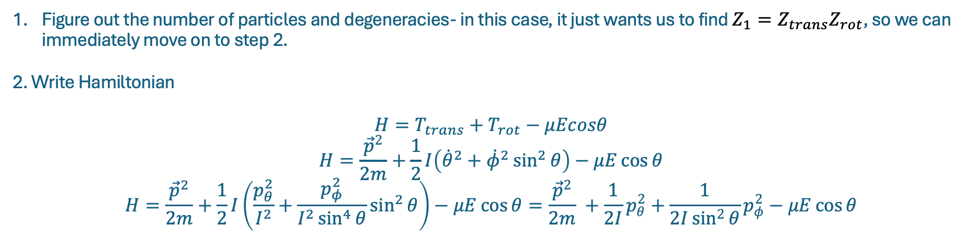
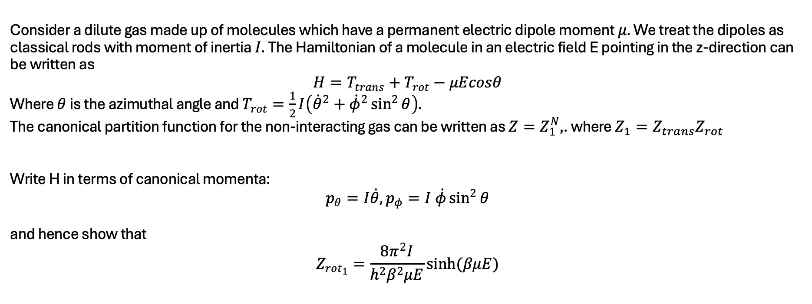
Consider a dilute gas made up of molecules which have a permanent electric dipole moment $μ.$ We treat the dipoles as classical rods with moment of inertia $I.$The Hamiltonian of a molecule in an electric field E pointing in the z-direction can be written as $$H=T_{trans}+T_{rot}−μEcosθ$$ Where $θ$ is the azimuthal angle and $T_{rot}=\frac{1}{2}I\left({\dot{θ}}^{2}+{\dot{φ}}^{2}\sin^{2}{θ}\right).$ The canonical partition function for the non-interacting gas can be written as $Z=Z_{1}^{N}$,. where $Z_{1}=Z_{trans}Z_{rot}$ Write H in terms of canonical momenta: $$p_{θ}=I\dot{θ}, p_{φ}=I \dot{φ}\sin^{2}{θ}$$ and hence show that $$Z_{rot_{1}}=\frac{8π^{2}I}{h^{2}β^{2}μE}sinh(βμE)$$
Figure out the number of particles and degeneracies- in this case, it just wants us to find $Z_{1}=Z_{trans}Z_{rot}$, so we can immediately move on to step 2.
2. Write Hamiltonian
$$H=T_{trans}+T_{rot}−μEcosθ$$
$$H=\frac{{\vec{p}}^{2}}{2m}+\frac{1}{2}I\left({\dot{θ}}^{2}+{\dot{φ}}^{2}\sin^{2}{θ}\right)−μE\cos{θ}$$
$$H=\frac{{\vec{p}}^{2}}{2m}+\frac{1}{2}I\left(\frac{p_{θ}^{2}}{I^{2}}+\frac{p_{φ}^{2}}{I^{2}\sin^{4}{θ}}\sin^{2}{θ}\right)−μE\cos{θ}=\frac{{\vec{p}}^{2}}{2m} +\frac{1}{2I}p_{θ}^{2}+\frac{1}{2I\sin^{2}{θ}}p_{φ}^{2}−μE\cos{θ}$$

Slide 15
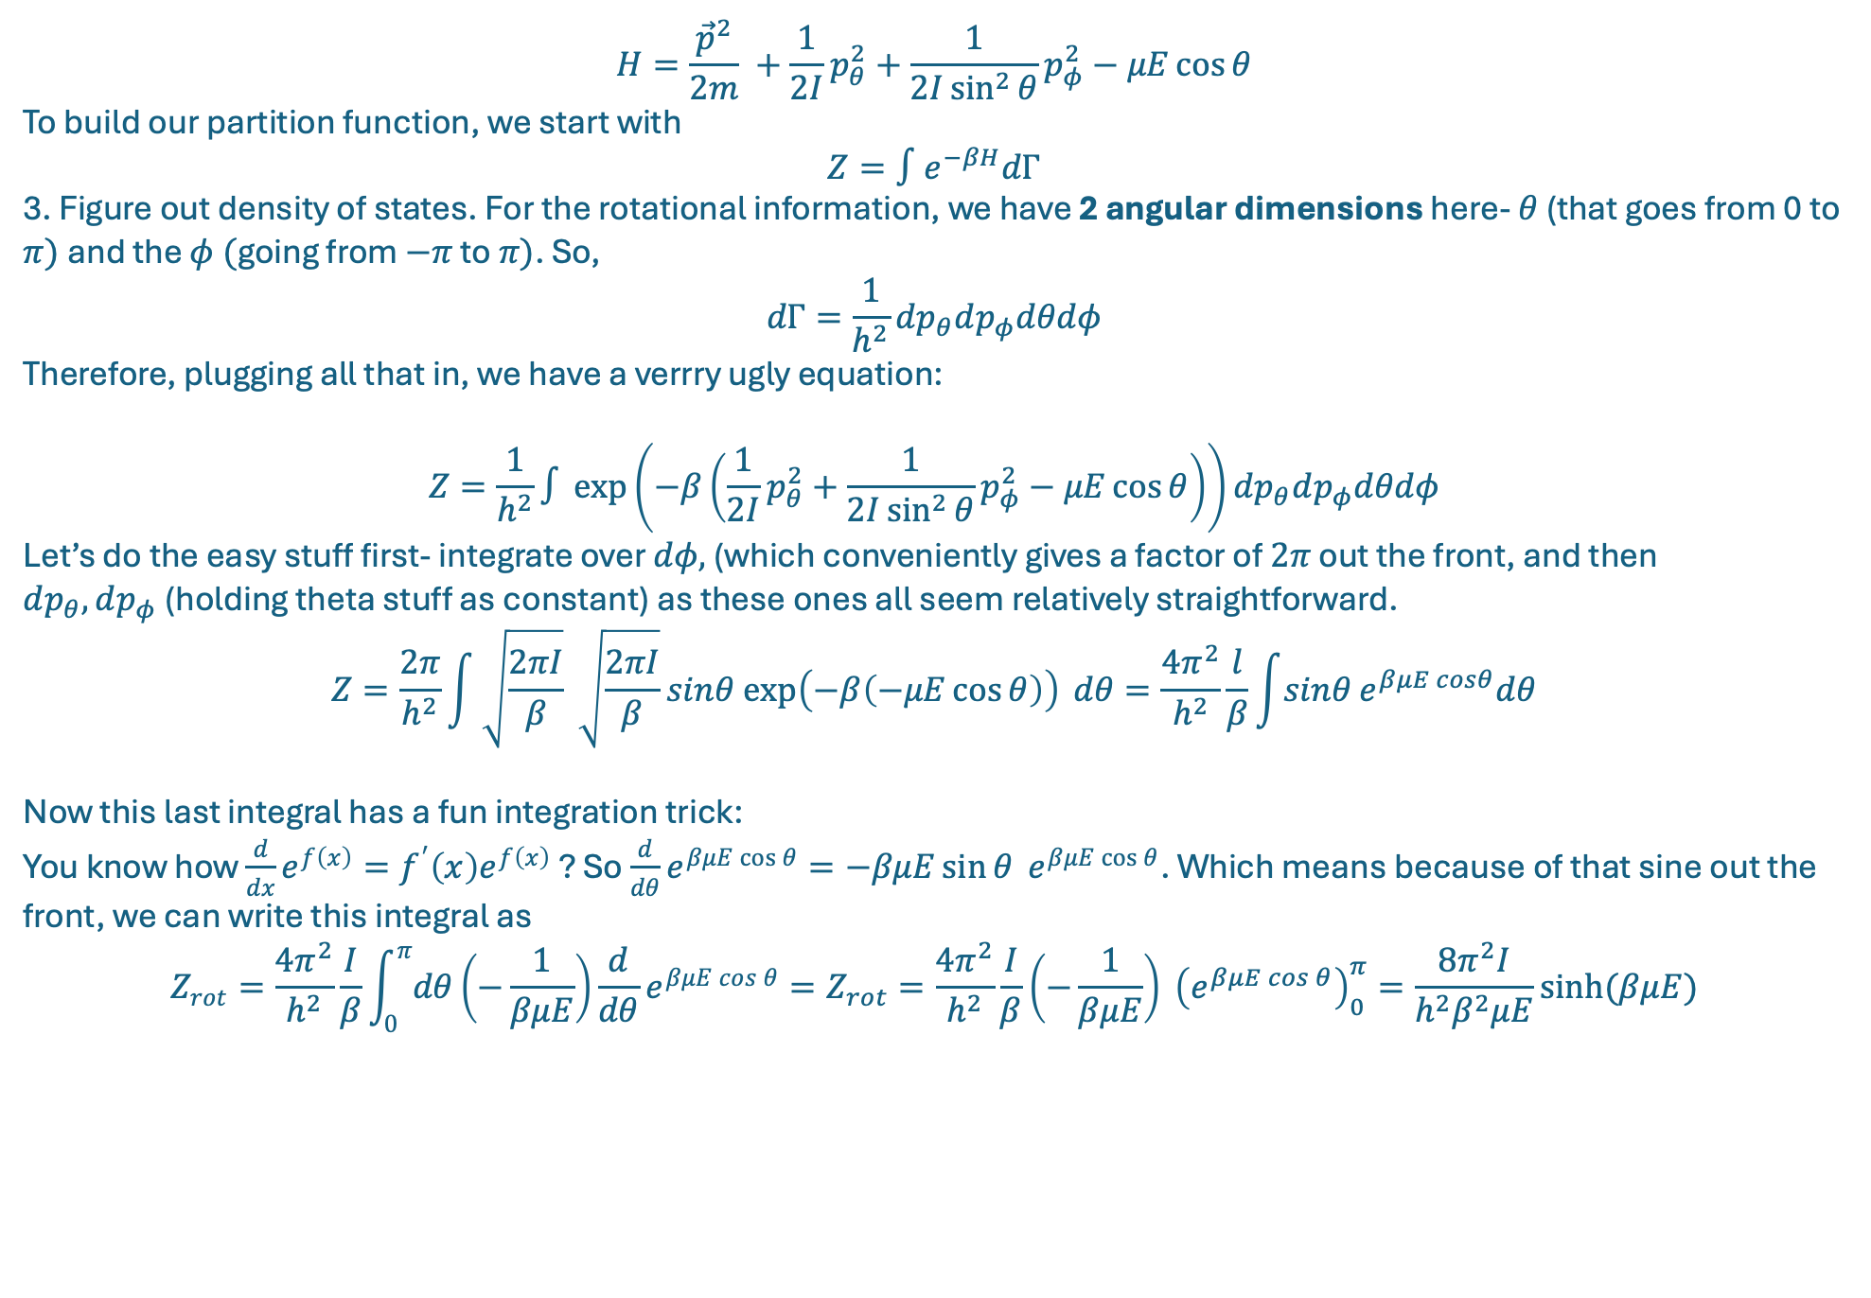
$$H=\frac{{\vec{p}}^{2}}{2m} +\frac{1}{2I}p_{θ}^{2}+\frac{1}{2I\sin^{2}{θ}}p_{φ}^{2}−μE\cos{θ}$$
To build our partition function, we start with
$$Z=∫e^{−βH}dΓ$$
3. Figure out density of states. For the rotational information, we have 2 angular dimensions here- $θ$ (that goes from 0 to $π)$and the $φ ($going from $−π$ to $π)$. So,
$$dΓ=\frac{1}{h^{2}}dp_{θ}dp_{φ}dθdφ$$
Therefore, plugging all that in, we have a verrry ugly equation:
$$Z=\frac{1}{h^{2}}∫{\exp\left(−β\left(\frac{1}{2I}p_{θ}^{2}+\frac{1}{2I\sin^{2}{θ}}p_{φ}^{2}−μE\cos{θ}\right)\right)}dp_{θ}dp_{φ}dθdφ$$
Let’s do the easy stuff first- integrate over $dφ,$(which conveniently gives a factor of $2π$ out the front, and then $dp_{θ},dp_{φ}$(holding theta stuff as constant) as these ones all seem relatively straightforward.
$$Z=\frac{2π}{h^{2}}\int{\sqrt{\frac{2πI}{β}} \sqrt{\frac{2πI}{β}}sinθ exp\left(−β\left(−μE\cos{θ}\right)\right)}{dθ}=\frac{4π^{2}}{h^{2}}\frac{l}{β}\int{sinθ}e^{βμE cosθ}dθ$$
Now this last integral has a fun integration trick:
You know how $\frac{d}{dx}e^{f\left(x\right)}=f^{′}\left(x\right)e^{f\left(x\right)}$ ? So $\frac{d}{dθ}e^{βμE\cos{θ}}=−βμE\sin{θ} e^{βμE\cos{θ}}$. Which means because of that sine out the front, we can write this integral as
$$Z_{rot}=\frac{4π^{2}}{h^{2}}\frac{I}{β}\int_{0}^{π}{dθ}\left(−\frac{1}{βμE}\right)\frac{d}{dθ}e^{βμE\cos{θ}}=Z_{rot}=\frac{4π^{2}}{h^{2}}\frac{I}{β}\left(−\frac{1}{βμE}\right) {\left(e^{βμE\cos{θ}}\right)}_{0}^{π}=\frac{8π^{2}I}{h^{2}β^{2}μE}sinh⁡(βμE)$$

Slide 16
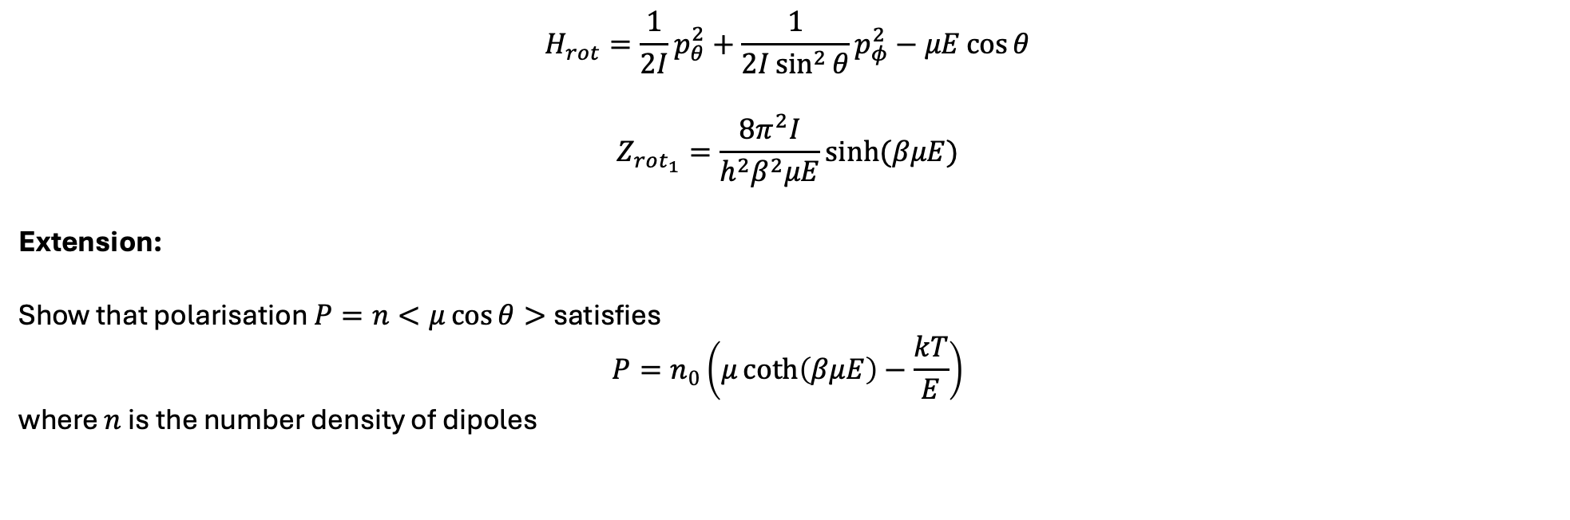
$$H_{rot}=\frac{1}{2I}p_{θ}^{2}+\frac{1}{2I\sin^{2}{θ}}p_{φ}^{2}−μE\cos{θ}$$
$$Z_{rot_{1}}=\frac{8π^{2}I}{h^{2}β^{2}μE}sinh(βμE)$$
Extension:
Show that polarisation $P=n<μ\cos{θ> }$satisfies
$$P=n_{0}\left(μ\coth\left(βμE\right)−\frac{kT}{E}\right)$$
where $n$ is the number density of dipoles

Slide 17

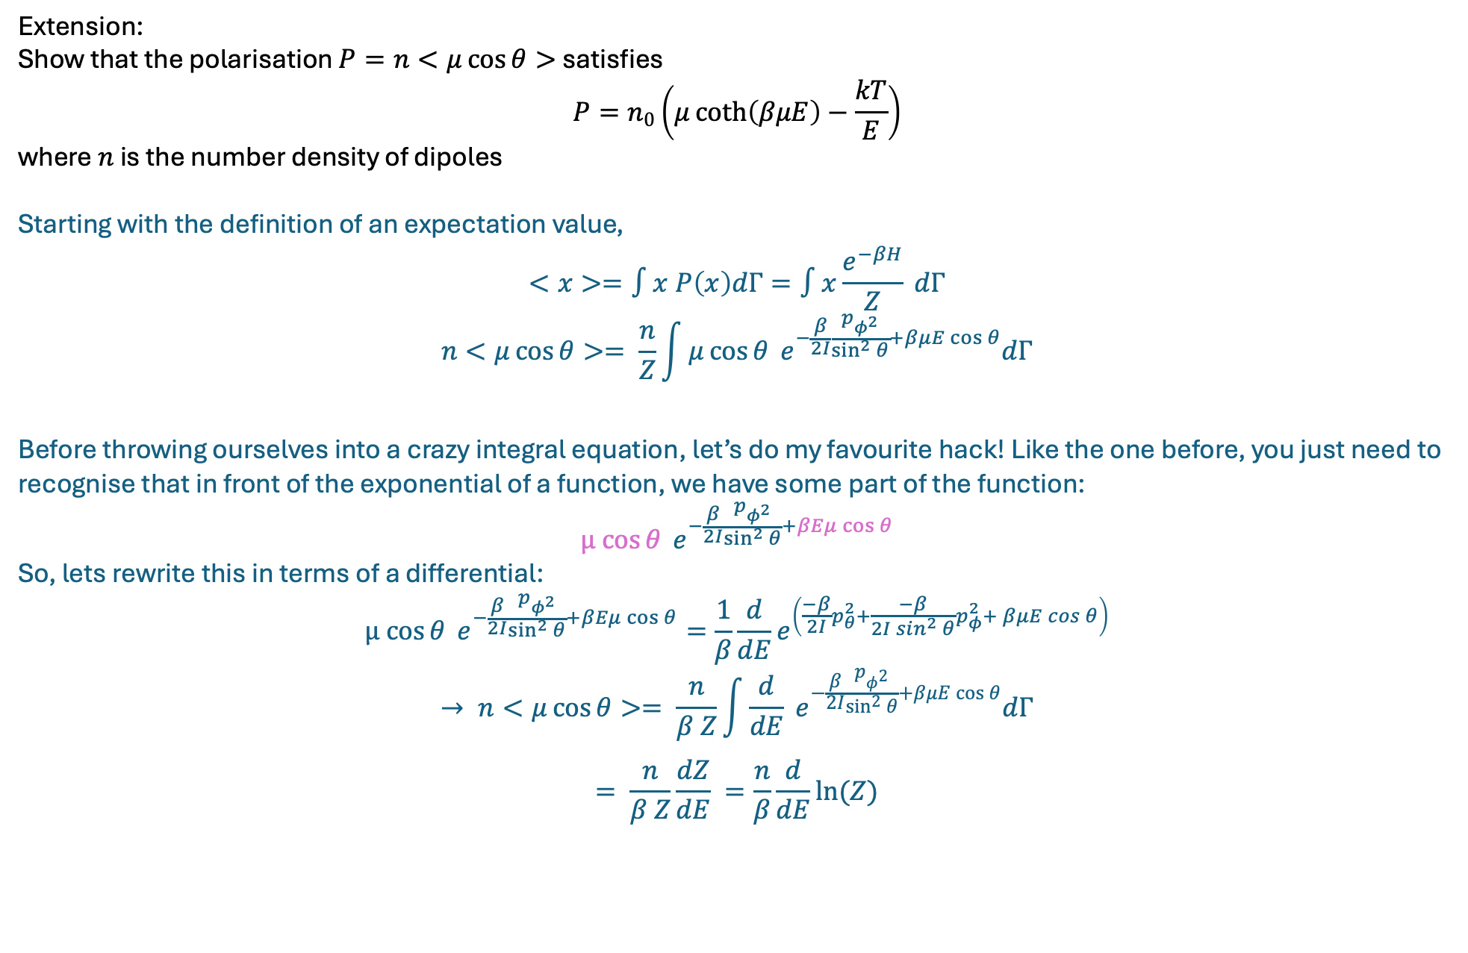
Extension:
Show that the polarisation $P=n<μ\cos{θ> }$satisfies
$$P=n_{0}\left(μ\coth\left(βμE\right)−\frac{kT}{E}\right)$$
where $n$ is the number density of dipoles
Starting with the definition of an expectation value,
$$<x>=∫x P\left(x\right)dΓ=∫x\frac{e^{−βH}}{Z} dΓ$$
$$n<μ\cos{θ}>= \frac{n}{Z}\int{μ\cos{θ} e^{−\frac{β}{2I}\frac{p_{φ^{2}}}{\sin^{2}{θ}}+βμE\cos{θ}}dΓ}$$
Before throwing ourselves into a crazy integral equation, let’s do my favourite hack! Like the one before, you just need to recognise that in front of the exponential of a function, we have some part of the function:
$$μ cos{θ} e^{−\frac{β}{2I}\frac{p_{φ^{2}}}{\sin^{2}{θ}}+βEμ\cos{θ}}$$
So, lets rewrite this in terms of a differential:
$$μ cos{θ} e^{−\frac{β}{2I}\frac{p_{φ^{2}}}{\sin^{2}{θ}}+βEμ\cos{θ}}=\frac{1}{β}\frac{d}{dE}e^{\left(\frac{−β}{2I}p_{θ}^{2}+\frac{−β}{2I\sin^{2}{θ}}p_{φ}^{2}+ βμE\cos{θ}\right)}$$
$$→ n<μ\cos{θ}>= \frac{n}{β Z}\int{\frac{d}{dE} e^{−\frac{β}{2I}\frac{p_{φ^{2}}}{\sin^{2}{θ}}+βμE\cos{θ}}dΓ}$$
$$= \frac{n}{β Z}\frac{dZ}{dE} =\frac{n}{β}\frac{d}{dE}ln(Z)$$
$$Z_{rot_{1}}=\frac{8π^{2}I}{h^{2}β^{2}μE}sinh(βμE)$$

Slide 18

$$Z_{rot_{1}}=\frac{8π^{2}I}{h^{2}β^{2}μE}sinh(βμE)$$
$$∴P=\frac{n}{β}\frac{d}{dE}ln(Z)$$
$$P=\frac{n}{β}\frac{d}{dE}\ln\left(\frac{8π^{2}I}{h^{2}β^{2}μE}\sinh\left(βμE\right)\right)$$
$$=\frac{n}{β}\frac{d}{dE}\left(−\ln\left(E\right)+\ln\left(\sinh\left(βμE\right)\right)+constants wrt E\right)$$
$$=\frac{n}{β}\left(−\frac{1}{E}+μβ\coth{βμE}\right)=nμ\coth{βμE}−\frac{n}{βE}$$

